Slide 1
Design Patterns

Slide 2

Patterns
Pattern photo by Vinoth Chandar from flickr used under CC BY

Slide 3
Design patterns, are general, reusable solutions to a commonly occurring problem within a given context in software design.

Slide 4
Design Patterns
Unlike algorithms, design patterns are not clear instructions that can automatically be transferred to your system.

Slide 5
Design Patterns
Design patterns are more like templates that describe the general concept to solve the problem.
It doesn’t contain implementation details; it contains structural blueprints.

Slide 6
History of Design Patterns
Design patterns are not novel and sophisticated discoveries, they are instead, typical solutions to common problems.

Slide 7
History of Design Patterns
The pattern of these solutions become so ubiquitous that it becomes worthwhile to put a name to it.

Slide 8
History of Design Patterns
Design patterns in software engineering are just borrowed concepts from architecture/design.

Slide 9
History of Design Patterns
The concept of design patterns is often attributed to Christopher Alexander, from his book, A Pattern Language: Towns, Buildings, Construction
Notes:
They may describe how high windows should be, how many levels a building should have, how large green areas in a neighborhood are supposed to be, and so on.

Slide 10
History of Design Patterns
Four software engineers, Erich Gamma, John Vlissides, Ralph Johnson, and Richard Helm, used this as an inspiration to publish the famous book, Design Patterns: Elements of Reusable Object-Oriented Software.

Slide 11
History of Design Patterns
The four became collectively known as the “Gang of Four”. And their book became known as the GoF book.
It contains a catalog of 23 design patterns solving various problems of OOP design.

Slide 12
Why patterns?
The answer to this problem is similar to the reason as to why you don’t “reinvent the wheel”

Slide 13
Why patterns?
Design patterns are tried and tested solutions, knowing these patterns give programmers a toolset to solve a variety of problems in software design.

Slide 14
Why patterns?
Design patterns also help with communication.
A team of software engineers well versed in design patterns wouldn’t need to explain to each other what exactly must be done to use an “Adapter pattern”

Slide 15
Why not patterns?
Design patterns are sometimes used to simulate features that the programming language doesn’t have

Slide 16
Why not patterns?
If you use a powerful enough language you wouldn’t need the pattern at all.
Example of this is how the Strategy pattern can be replaced by lambdas

Slide 17
Why not patterns?
Patterns are not end-all be-all solutions to any design problem out there. At the end of the day context matters the most.
An inexperienced programmer will implement a problem to the dot, instead of adapting the pattern for the context

Slide 18
Why not patterns?
Sometimes, you don’t need a pattern at all.
A simple problem solved using a complicated solution is inelegant
Notes:
If all you have is a hammer, everything looks like a nail.

Slide 19
Classifications of Patterns
Creational patterns
Structural patterns
Behavioral patterns
Notes:
Creational patterns provide object creation mechanisms that increase flexibility and reuse of existing code.
Structural patterns explain how to assemble objects and classes into larger structures, while keeping the structures flexible and efficient.
Behavioral patterns take care of effective communication and the assignment of responsibilities between objects.

Slide 20
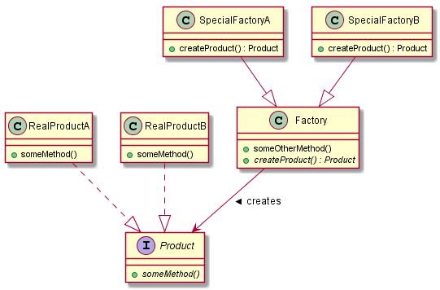
Factory method pattern

Slide 21
References
Pattern photo by Vinoth Chandar from flickr used under CC BY
Alexander (1977). A Pattern Language: Towns, Buildings, Construction.
Gamma, Vlissides, Johnson, and Helm (1994). Design Patterns: Elements of Reusable Object-Oriented Software

